Slide 1
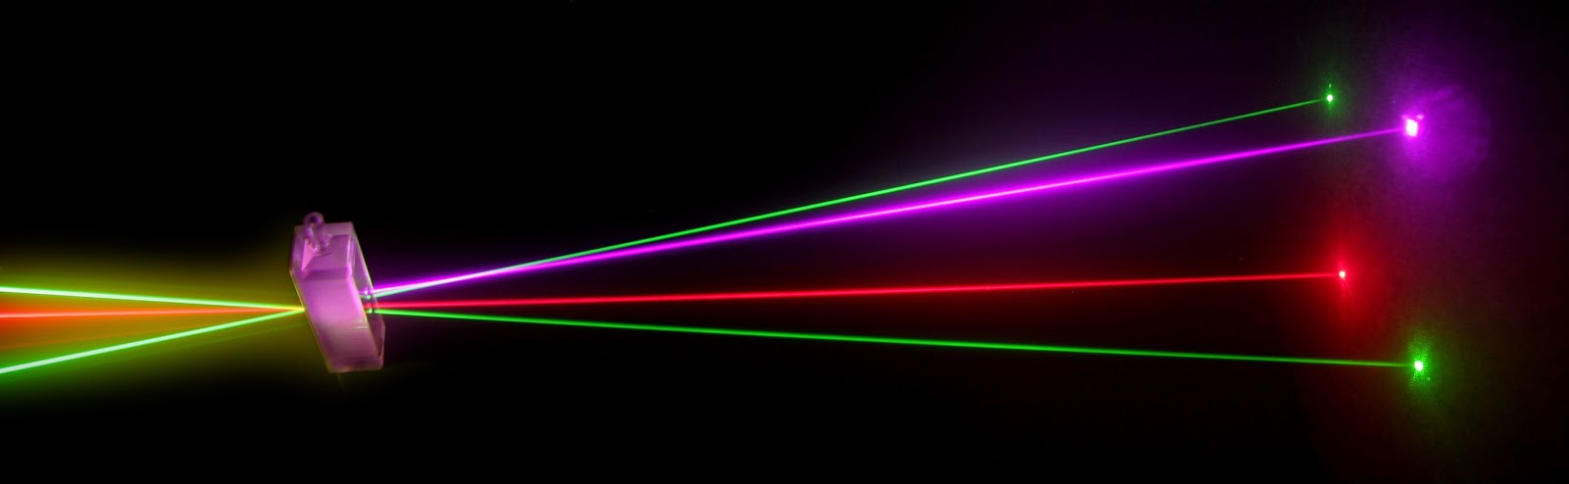
“Laser Technology and Applications”
16B1NPH533
Lecture 20

Slide 2
Lecture 20
Content Outlines
Mode
  Longitudinal modes
  Transverse Modes

Slide 3
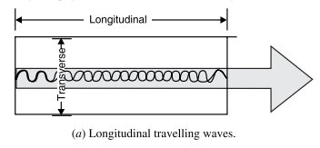
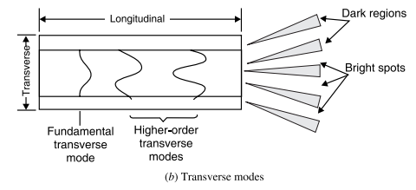
Modes
A wave of frequency ν that travels along the axis of the cavity forms a series of standing waves within the cavity. They are discrete resonant conditions determined by the physical dimensions of the cavity.
The laser modes governed by the axial dimension of the resonant cavity are called the longitudinal modes or axial modes. The laser modes determined by the cross-sectional dimension of the optical cavity are called the transverse modes.

Slide 4
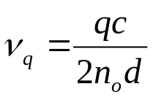
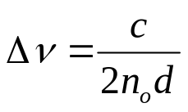
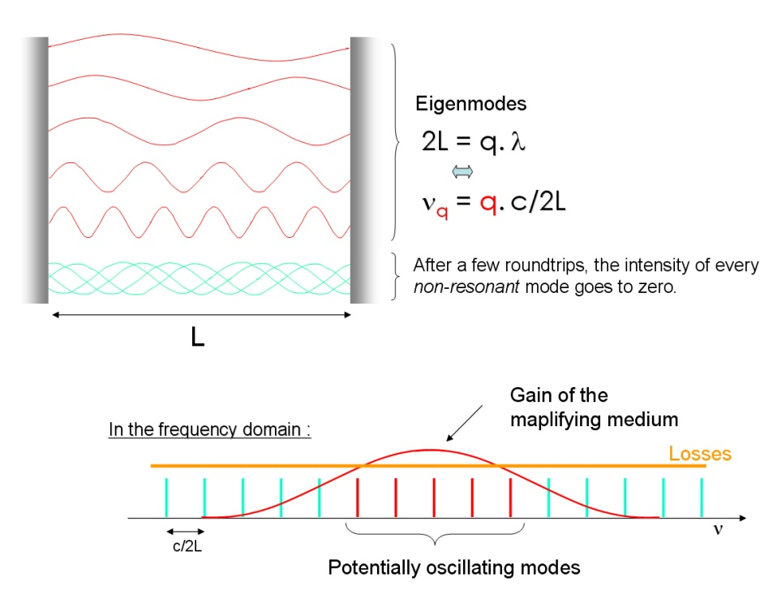
Longitudinal Modes
If we consider a cavity flanked by two plane parallel mirrors, the standing waves in the cavity satisfy the condition.
The frequency separation Δν between adjacent modes is given by
As Δν is independent of q, the frequency separation of adjacent modes is the same irrespective of their actual frequencies. All the axial modes contribute to a single spot of light in the laser output. Many lasers tend to have naturally many modes. The co-existence of multiple modes reduces the monochromaticity of the laser light, and therefore leads to poor coherence.

Slide 5
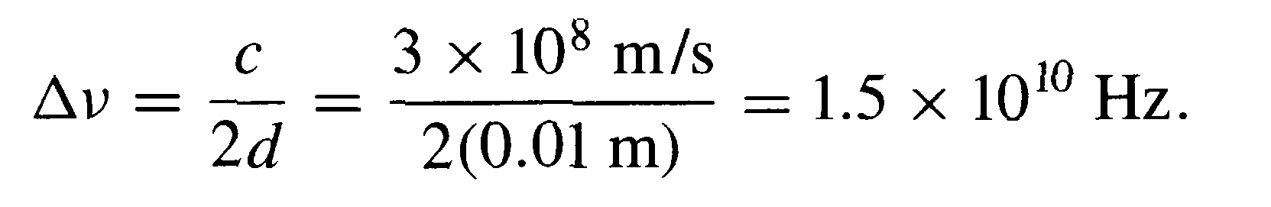
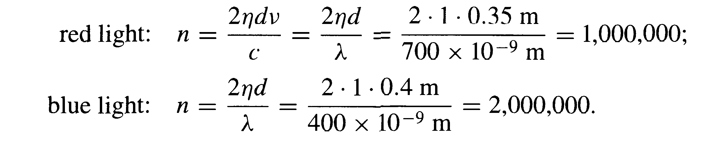
Determine the frequency difference between successive maxima for a Fabry-Perot etalon in which the mirrors are separated by 0.01 m and the mirrors are located in air.
Determine the mode numbers at the extreme ends of the optical frequency region for the following examples: a wavelength of 700 nm in the red and a spacing of d — 0.35 m; and a wavelength of 400 nm in the blue and a spacing of d = 0.4 m.

Slide 6
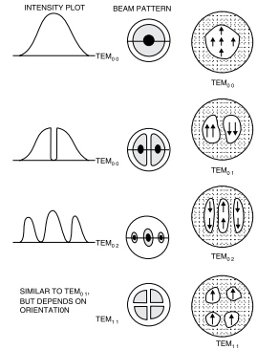
Transverse Mode
In addition to the axial modes, a laser output is characterized by Transverse Electro Magnetic (TEM) modes. The TEM modes are generally few in number and they are easy to see. If the laser beam is spread out by a negative lens, and focussed on to a screen, several bright patches will be seen on the screen. The patches are separated by intervals called nodal lines. Within each patch, the phase of light is the same, but, between patches the phase is reversed

Slide 7
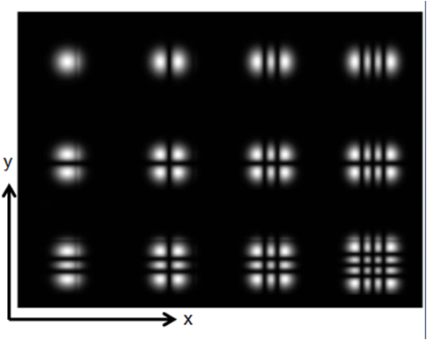
The distribution of the radiation intensity being across the cross-sectional area perpendicular to the optical laser access has different shape.
These different shapes depend on position of the mirror. Any change on the mirror position change the shapes which are known as Transverse mode.
Using a single lens and a screen to magnify the Transformers mode in a laser beam
TEM_{mn} m n are integer numbers
Assume in the beam advance in z direction
m =number of points of zeros elimination
along x axis
n= equal to number of points of zero
illumination(between illuminated
regions) along y axis

Slide 8
